Slide 1
程式設計實習(一)

Slide 2
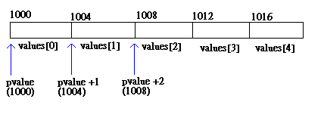
Pointer & Array
…
long values[5];
long* pvalue = values;
pvalue += 1;// or pvalue++
…

Slide 3
new & delete
…
double* pvalue = 0;
pvalue = new double;
*pvalue = 999.0;
…
delete pvalue;
…
…
double* pvalue = new double(999.0);
…
delete pvalue;
…

Slide 4
new & delete
…
char* pstring = 0;
pstring = new char[20];
…
delete [] pstring;
pstring = 0;
…

Slide 5
Hw 11
Input
Enter the number of primes.
Output
All of primes.
Need “new” and “delete”

Slide 6
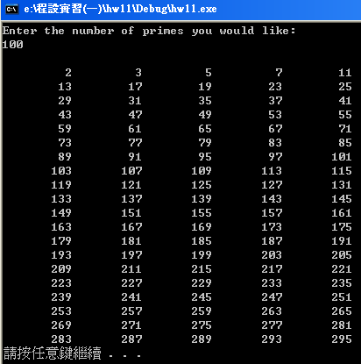
Hw 7

